Slide 1
STUDY ON ITEL

Slide 2
Overview
About Itel
Objectives
Topic Summary
Analysis of Questions
Findings
Conclusion

Slide 3
About Itel
Founded on 2012, started service on 13 July, 2014.
Previously known as Otel, later changed to Itel
30-40 thousand subscribers.
Service from east (Kakarbhitta) up-to West (Butwal)
25-30 branches established.

Slide 4
Objective of the Study
To relate the managerial theories so far acquired with the practical aspect.
To gain the knowledge of
Structure of the organization
The different levels of management
The acts and policies related managerial issues of the management
The ISP in Nepal.

Slide 5
Executive Summary
Formed in partnership 5 years ago and started its service 2 years ago.
Started their service from Kathmandu with 40 members.
Present coverage from Kakarbhitta to Butwal.
Has 25-30 branches.
Continuously forming new plans and strategies.
Has been motivating and encouraging.
Goal is to provide service to every people.
Some of the challenges : i. Recruiting low level staff. ii.Improving customer service. iiii.Decentralization of power.
Notes:
Hello hello mike testing
What are you doing?
I am fine. Lol srijal.
Who wrote lol srijal?

Slide 6
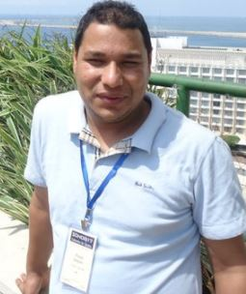
Analysis of Questions
Does your company organize any social service?
As a General Manager how do you motivate your employees to work better in company?
Is company’s power decentralized?
What plans did you made before starting this company?
What are your strategy to compete with other top ISP’s like World link and Vianet ?
How many sectors are there now and were the sectors separated from the beginning?
Kalyan Thapa,General Manager Itel communication pvt. ltd.

Slide 7
How do you plan?
How do you motivate the person who has not been able to work properly?
How do you take action? Do you change the branch that is not functioning properly?
How do you manage to provide the new training to employees?
Any message for young students?

Slide 8
Findings
The Top Level managers did many surveys to find out what people needs.
Currently coverage of Itel’s service ranges from Kakarbhitta(East) to Butwal(West).
Currently there are 13-14 sectors which includes sub-departments of Marketing department, Accounting department, Technical department and other sectors like admin, HR and so on.
Giving other services like TV’s channel and telephone
Power is centralized
Provide sponsorship in the sports as CSR.

Slide 9
Conclusions
Itel is in progressive phase and also providing customer with effective services.
It has been carrying out various social corporate responsibility.
It conducts various programs to motivate and enhance the skills of its employee.
The power being centralized, all the plans and policies are effectively executed in Itel.

Slide 10
THANK YOU

